Slide 1
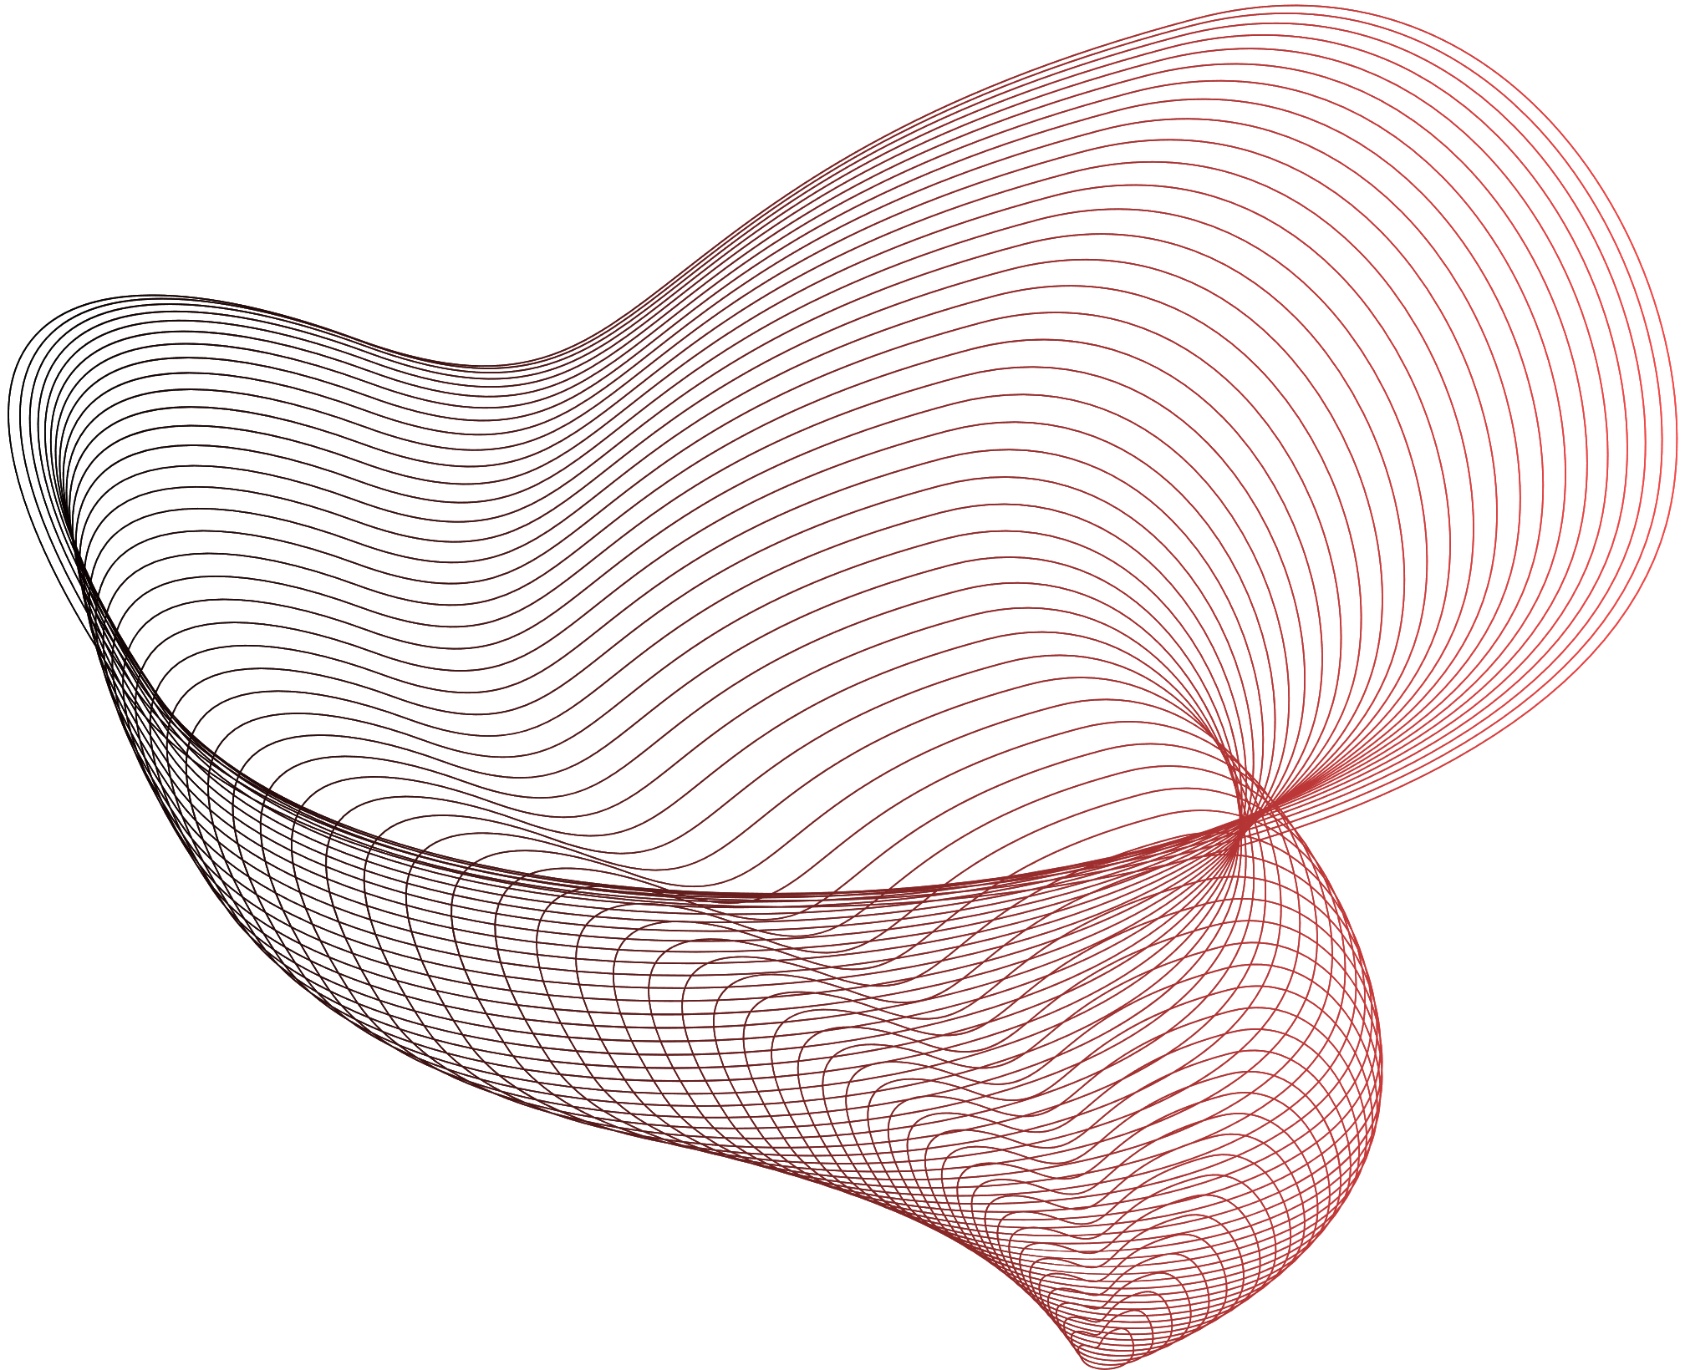




FIGHTING FIRE WITH FIRE
Robert Rafanelli, Claudia Ortiz, Joe Biju, Micheál Gill, Ray Foysal , Moaz Refaei

Slide 2
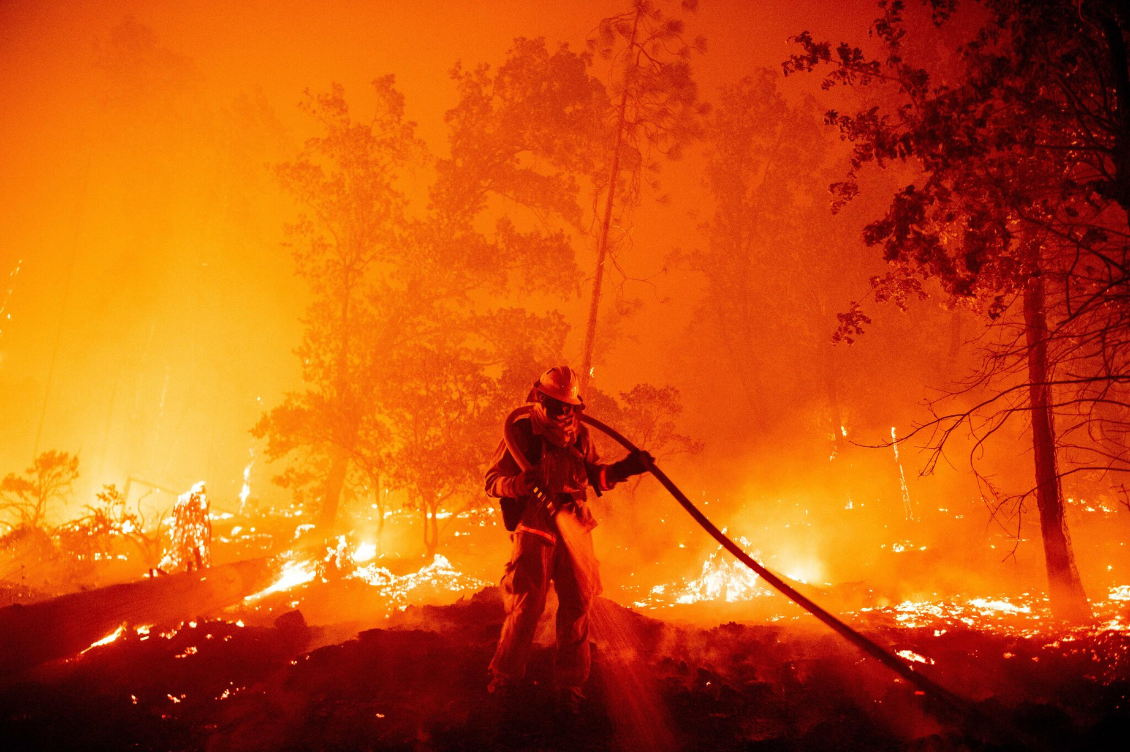
The Problem
Managing Fires: Increasing Community Based Fire Management Opportunities
According to NASA Worldview Data, satellite detections from 2021 displayed that remote communities in forested regions were disproportionately affected by wildfires.
The current information systems for many of these regions are predicated on satellite imagery alone.
Many locals are left without real-time mapping of the fires encroaching upon their communities

Slide 3
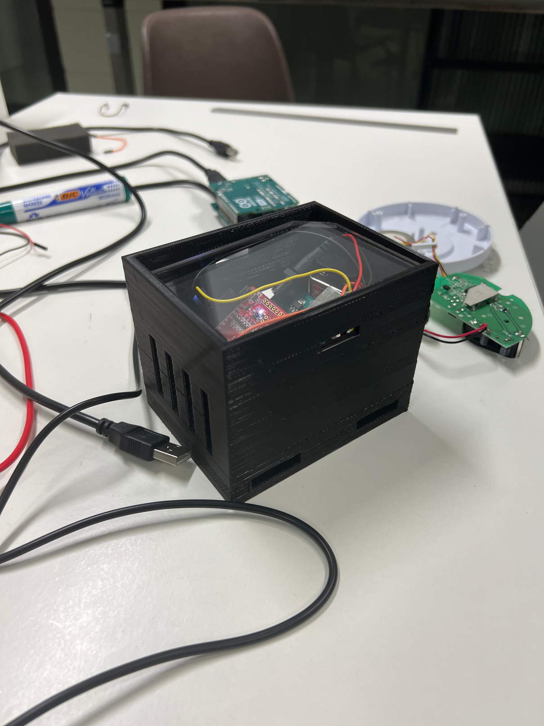

Our Solution
GOAL # 1
Real-Time data
GOAL # 2
On-the-ground mapping
GOAL # 3
Accessible to remote communities

Slide 4
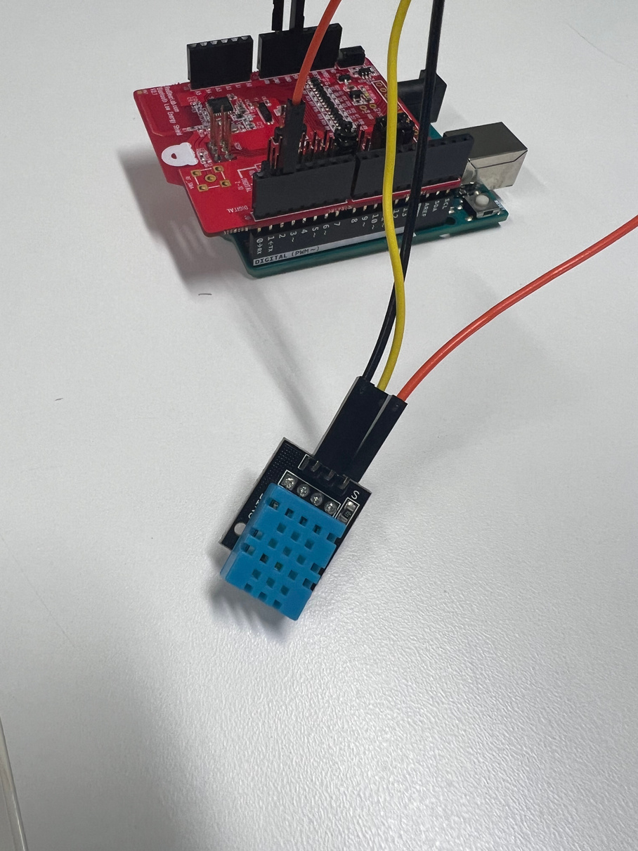
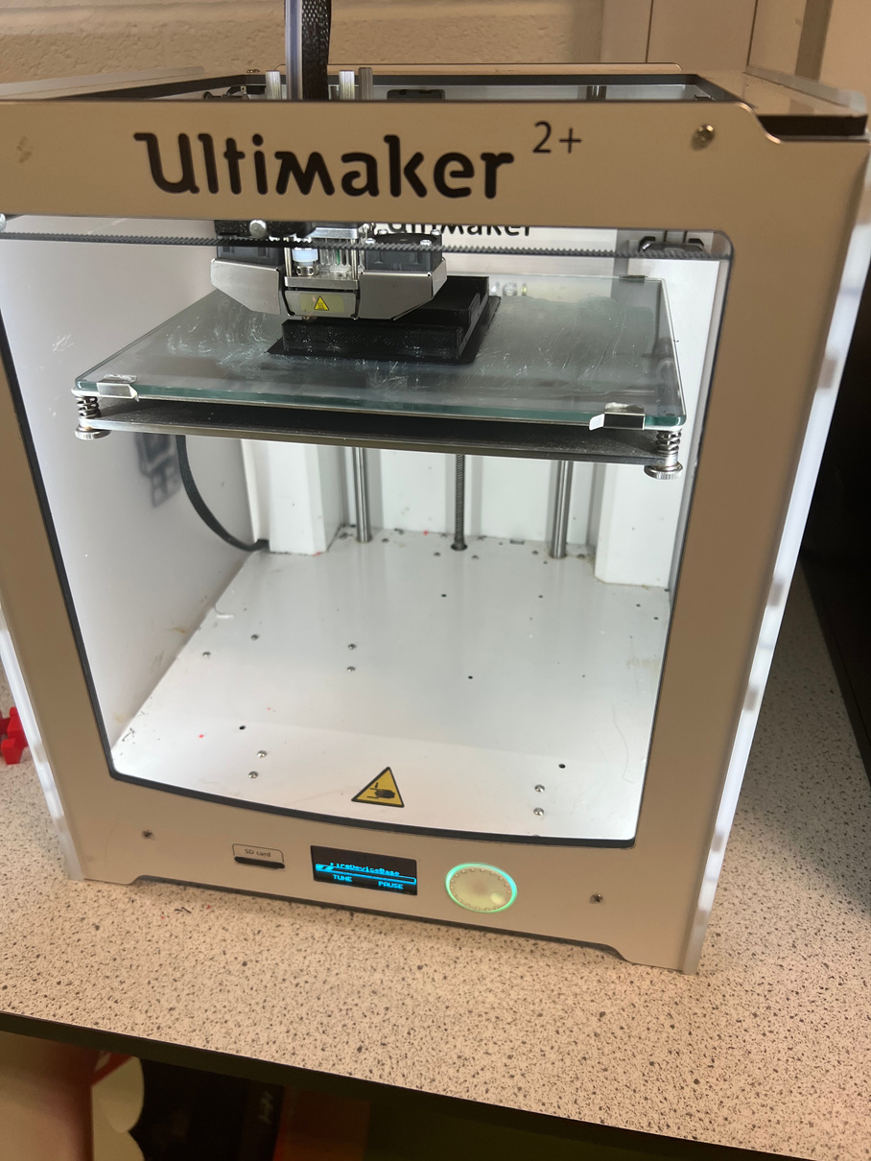
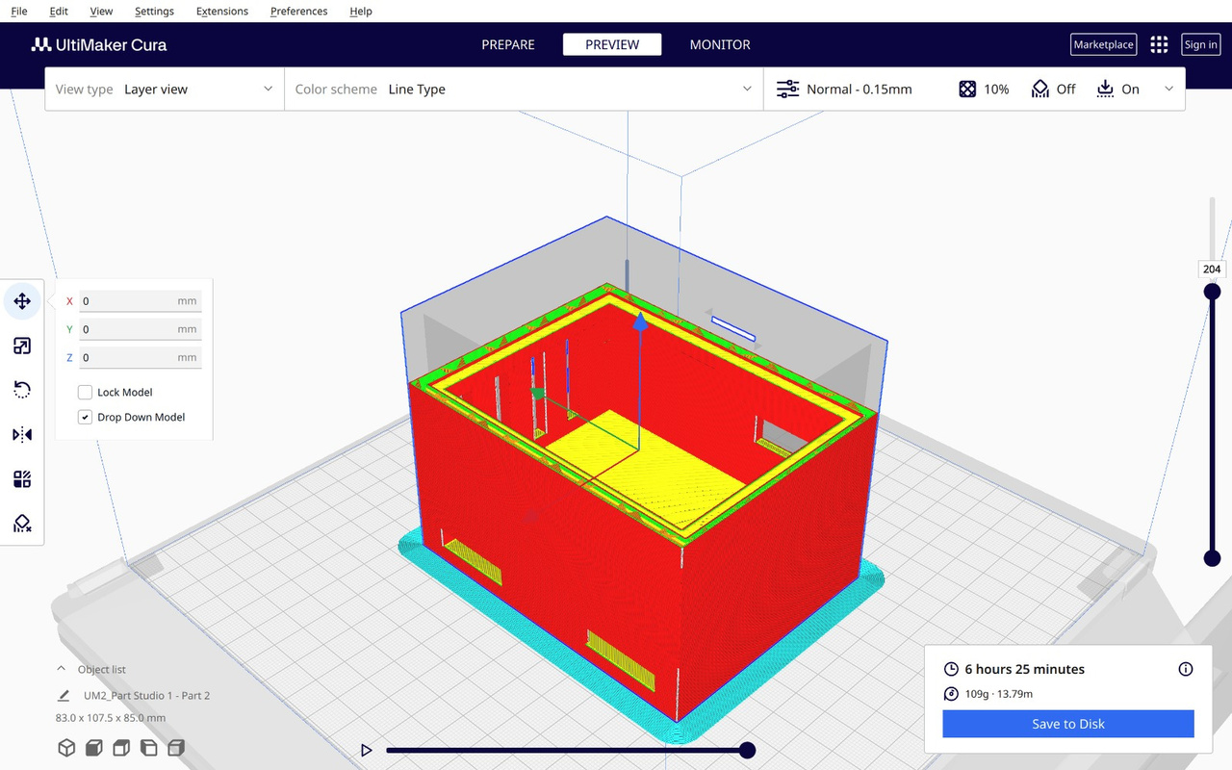
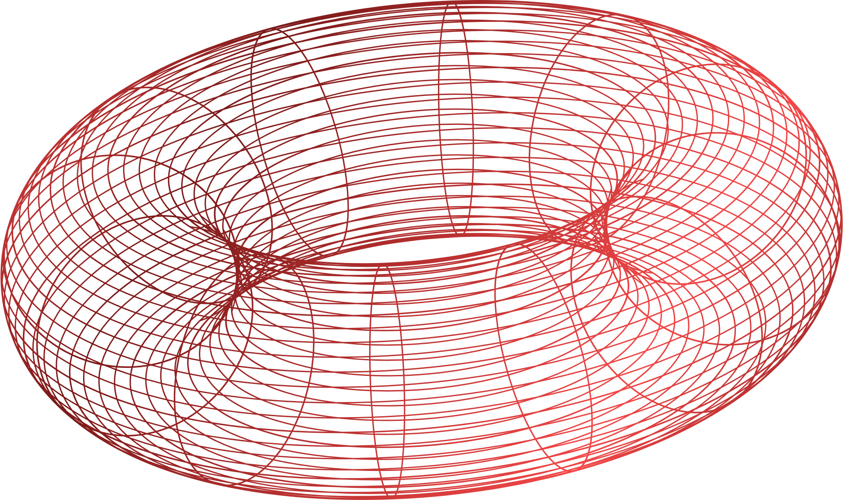
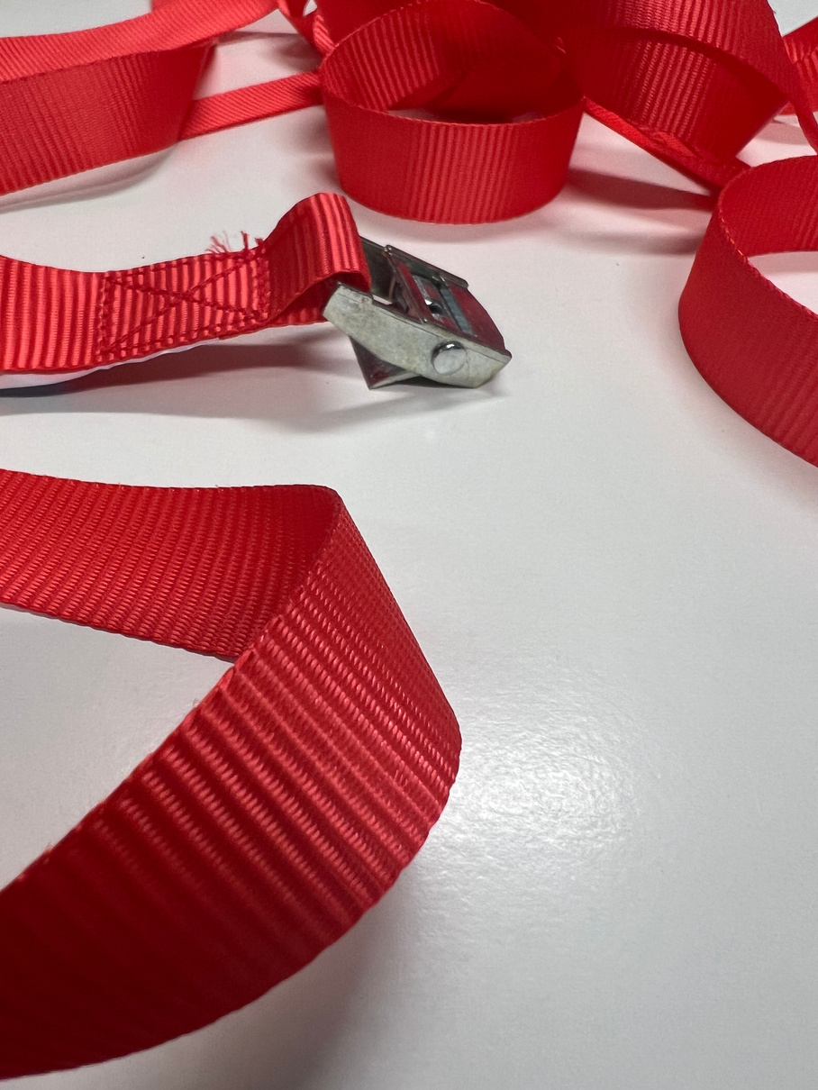
Development
LOW COST LOW MAINTENANCE LOW PRODUCTION TIME
BY THE NUMBERS
9V Battery
1 Year BL
€3.50 Components

Slide 5


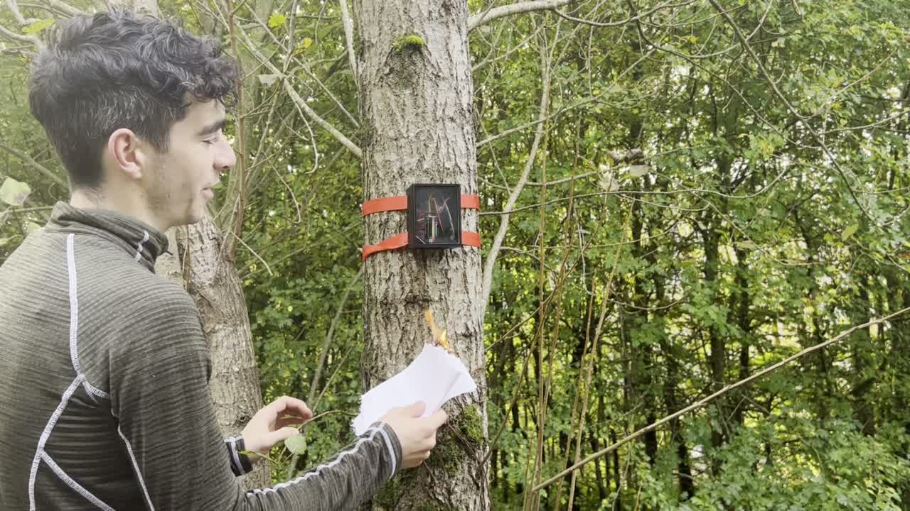
Prototype Simulation

Slide 6
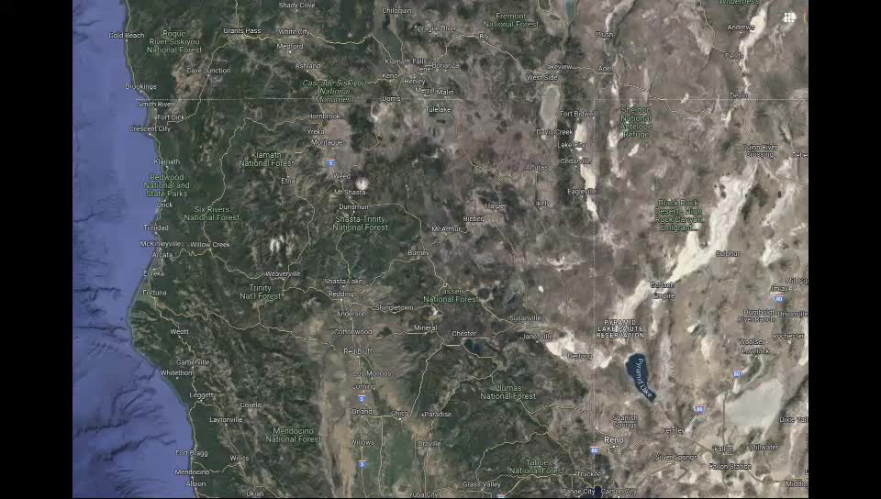
App Prototype

Slide 7

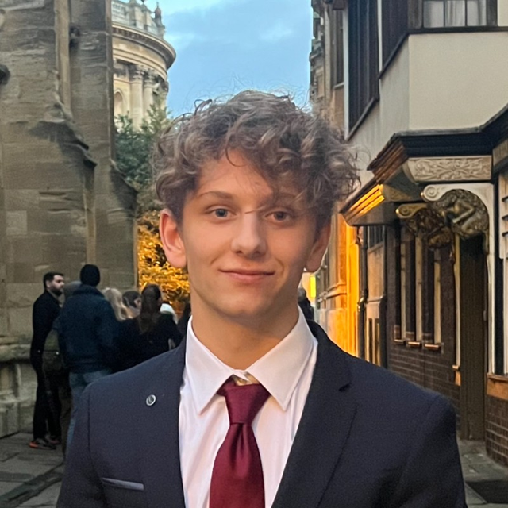
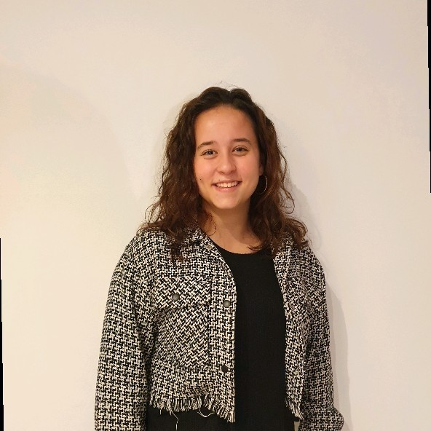
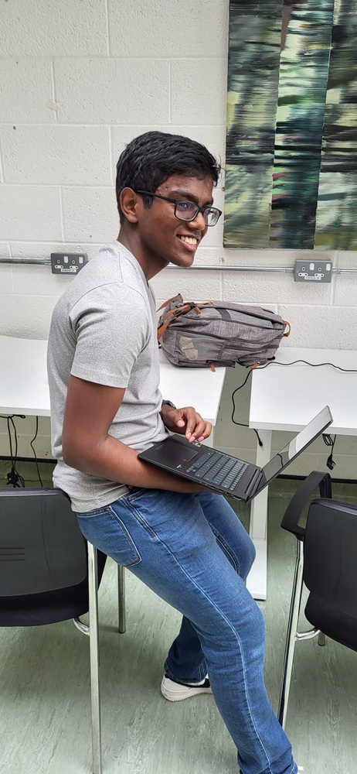
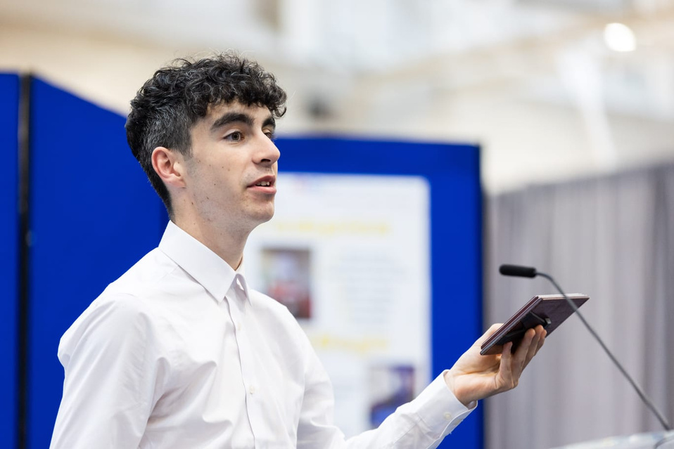
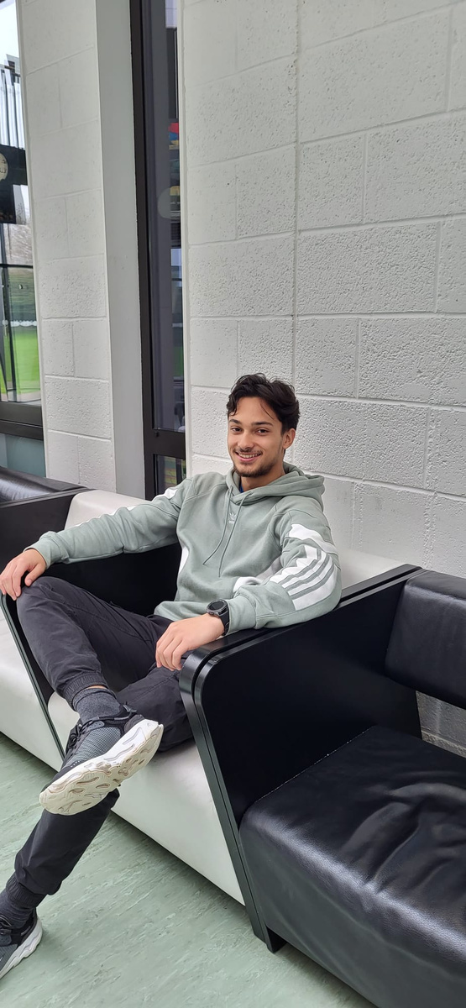
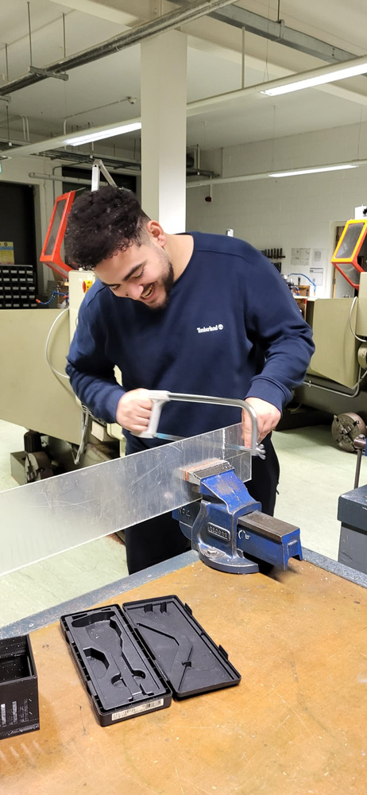
UCD
TUS / UFV
UCD
TUS
UCD
UCD
ROBERT RAFANELLI
2º YEAR BUSINESS
CLAUDIA ORTIZ
3º YEAR COMPUTER ENGINEERING STUDENT
ERASMUS
JOE
BIJU
1º YEAR ENGINEERING STUDENT
MICHEÁL GILL
2º YEAR MECHANICAL AND POLYMER ENGINEERING
RAY
FOYSAL
1º YEAR ENGINEERING STUDENT
MOAZ REFAEI
1º YEAR ENGINEERING STUDENT
GLOBAL EXCELLENCE SCHOLAR

